Slide 1
Management

Slide 2
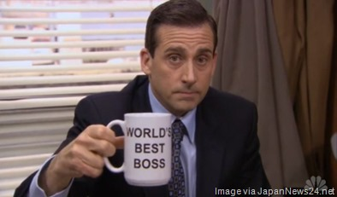
What’s a manager??
One who directs a business or other enterprise.
One who controls resources and expenditures, as of a household.
One who is in charge of the business affairs of an entertainer.

Slide 3
Plan
A basic management function involving formulation of one or more detailed plans to achieve optimum balance of needs or demands with the available resources.
By having a vision of a resource or goal that can benefit your company then putting it in a dynamic blueprint and as a standing platform that can lead you step by step to achieving that resource or goal.

Slide 4
Organize
“A first-rate Organizer is never in a hurry. He is never late. He always keeps up his sleeve a margin for the unexpected.” -Bennett, Arnold
. Arranging several elements into a purposeful sequential or spatial (or both) order or structure.

Slide 5
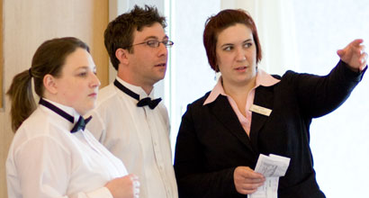
direct
To manage or conduct the affairs of; regulate.
Having to coordinate co-workers to accomplish a task and to negate any negative conditions and situations.

Slide 6
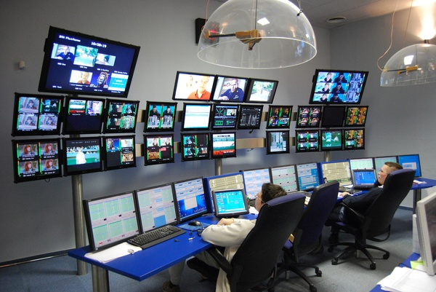
monitor
To check, supervise, watch, or keep track of.
By accomplishing all the planning and directing your co-workers towards the goal you have to observe that your co-workers are working cooperatively,effeciently and well.

Slide 7
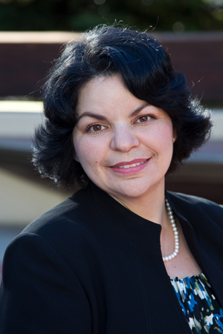
Great Manager Profile: Giselle Martin
Great managers come in all shapes and sizes. “Everyone has a different style,” says UCSF’s Giselle Martin, “the key is to embrace your style and build on your strengths.”
Her recipe for success comes from her own experience. “Since I started my career in entry level positions and, at times, performing similar roles, I know what it takes for them to get something accomplished. I’m a bit more sensitive to their needs.

Slide 8
Conclusion
A Manager has job fulfillment that is required to make a company or business to run as productive and efficiently as possible and to motivate his own co-workers and business partners to make the establishment of his company as successful as possible.

